Slide 1
Hidden Markov Models
CIS 530
University of Pennsylvania

Slide 2
Parts of Speech (POS)
Parts of speech (POS) classify words into different syntactic categories
Dionysius Thrax of Alexandria (c. 100 B.C.) gave description of 8 categories
Noun, Verb, Pronoun, Preposition, Adverb, Conjunction, Participle & Article
Today, Penn TreeBank (Mitch Marcus et al. ’93) define 45 word classes
Gives information about the word and also its neighbors
Nouns are likely to be preceded by determiners or adjectives
Verbs are mostly preceded by nouns
Influences morphological affixes and pronunciation
Eg, content as Noun: CONtent vs. Adjective: conTENT

Slide 3
Parts of Speech tagging
Computational method to assign POS tags to words in a sentence
Challenges:
Ambiguity: Same words can have different POS tags in different contexts.
Eg. I can can a can
Open Worldness: New words are invented whose POS tags are to be determined from context
iPhone, Google
gonna, ikr, fb, lolololol …

Slide 4
Hidden Markov Models (HMM)
Sequence Model
Input:
Let us learn about HMMs
Output
Labels
VB PRP VB IN NNP
Probabilistic Model
Compute a probability distribution over all possible sequence of labels
Let us learn about HMMs
VB PRP VB IN NNP
p=0.45
IN VB VB NN DT
p=0.03
…
PRP . NN IN WP
p=0.00006

Slide 5
Motivation for using HMMs
Why not build a classifier that maps input sequences to output sequences?
Input sequences are of different lengths
Output at different time steps are not independent
Let us learn about HMMs
VB PRP VB IN NNP
Important in practice
Text Processing
Speech Processing
DNA Analysis
….. basically any application requiring modeling sequences

Slide 6
Markov Chains aka Observed Markov Models

Slide 7
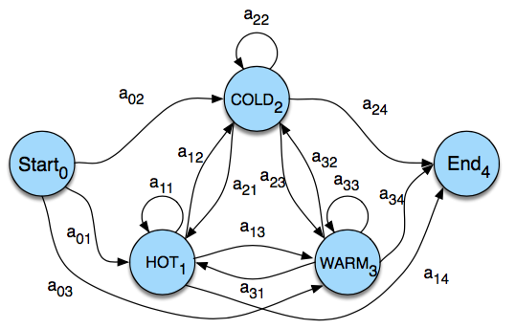
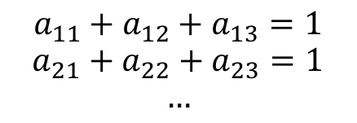
Observed Markov Models
Special case of Weighted Finite Automaton
Set of States
Set of transitions between states
In Markov Chains
Weights are probabilities
Therefore, sum of all probabilities on arcs leaving a node = 1
$$a_{11}+a_{12}+a_{13}=1$$
$$a_{21}+a_{22}+a_{23}=1$$
$$…$$
For eg.
- Cold, Warm, Hot, Hot, Hot
- Warm, Hot, Hot, Cold, Cold

Slide 8
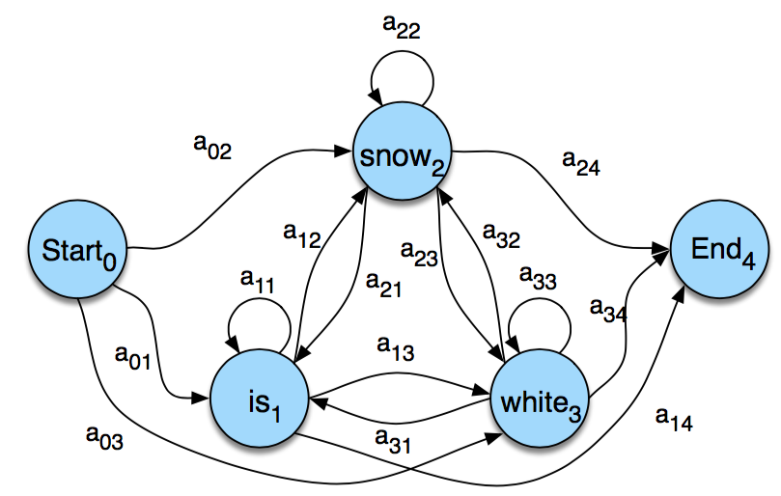
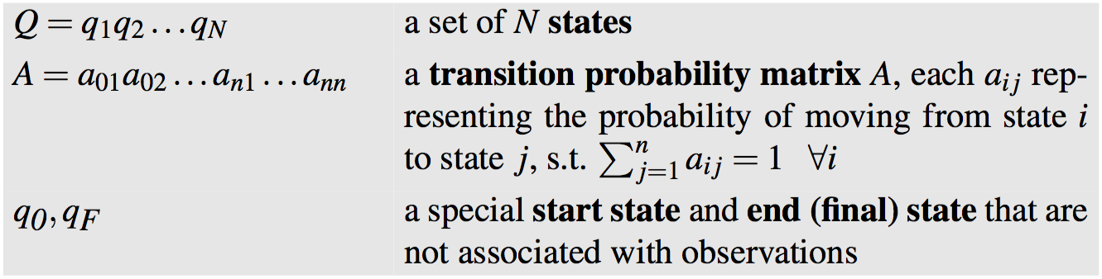
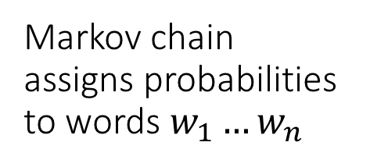
Observed Markov Models
Markov chain assigns probabilities to words $w_{1}…w_{n}$
is white snow
white is snow
is snow white
Bigram Language Model!
Markov Chains are Probabilistic Graphical Models

Slide 9
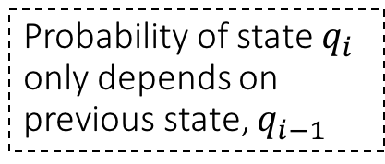
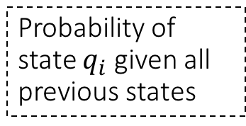
Observed Markov Models
Probability of state (at any given time-step) only depends on the previous state:
Probability of state $q_{i}$ given all previous states
Probability of state $q_{i}$ only depends on previous state, $q_{i−1}$

Slide 10
Hidden Markov Models
Used when events in the world are not directly observable
Parts-of-Speech (POS) tags
Reason about both, observed (ex. words) and hidden (ex. POS tags)
Observed Events
Let us learn about HMMs
Hidden
Events
VB PRP VB IN NNP
HMMs model this as a process where hidden events cause the occurrence of observed events

Slide 11
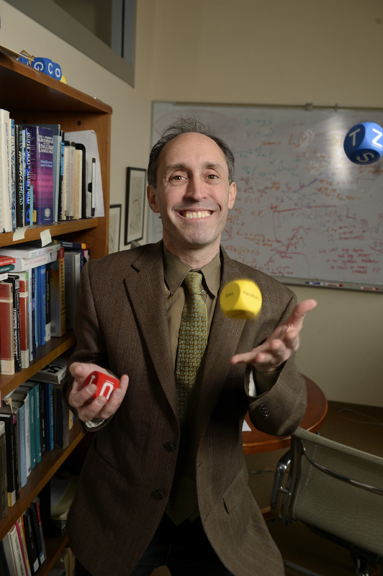
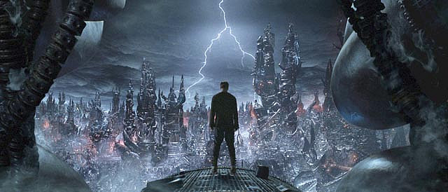
Jason Eisner’s Experiment
Year 2799; You are a climatologist
Job: Estimate the weather each day
Jason’s diary: How many ice-creams he ate everyday in 2007
Unobserved Events
Observed Events

Slide 12
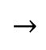





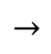
Jason Eisner’s Experiment
Ice-creams eaten each day
Input: Sequence of observations, O
Output: Sequence of hidden states, Q
Weather state each day
Unobserved Event
HOT
$$→$$
COLD
$$→$$
COLD
$$→$$
HOT
$$→$$
COLD
$$↓$$
$$↓$$
$$↓$$
$$↓$$
$$↓$$
Observed Event
2
2
1
3
2

Slide 13
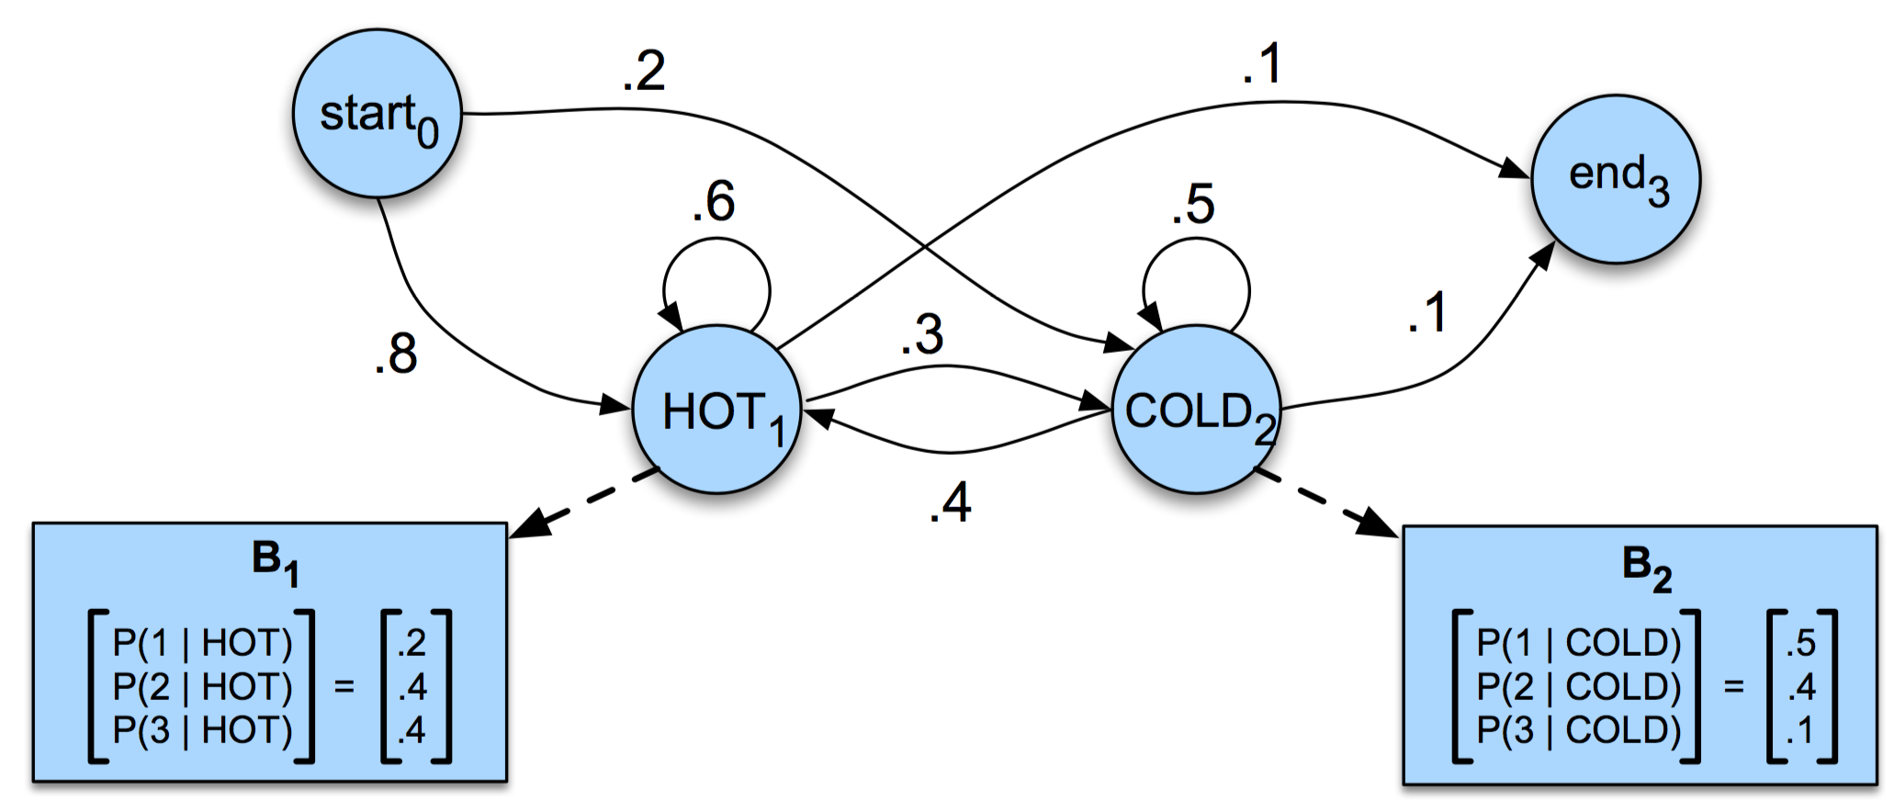
Hidden Markov Models
Similar to Markov Chain
Emission Probabilities
Given the day is hot, the probability of Jason eating two ice-creams = 0.4

Slide 14
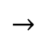
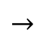





Hidden Markov Models
HOT
$$→$$
COLD
$$→$$
COLD
$$→$$
HOT
$$→$$
COLD
$$↓$$
$$↓$$
$$↓$$
$$↓$$
$$↓$$
2
2
1
3
2

Slide 15
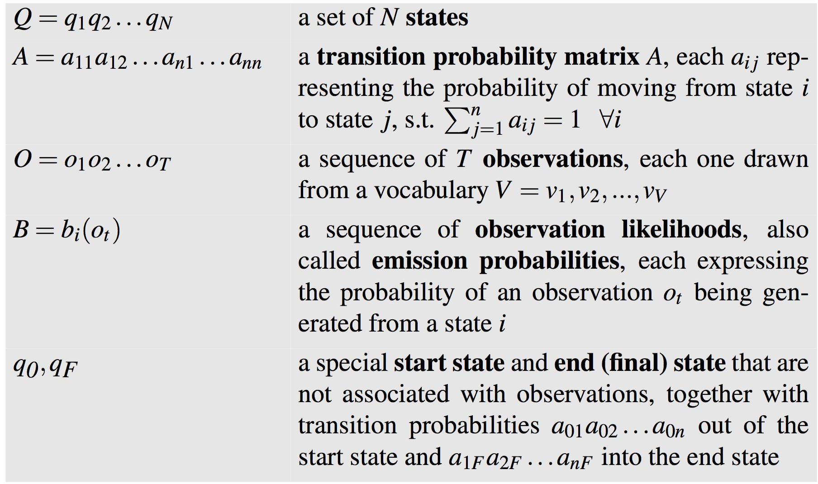
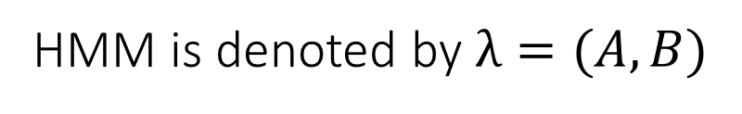
Hidden Markov Models
HMM is denoted by $λ=(A, B)$

Slide 16
Hidden Markov Models

Slide 17
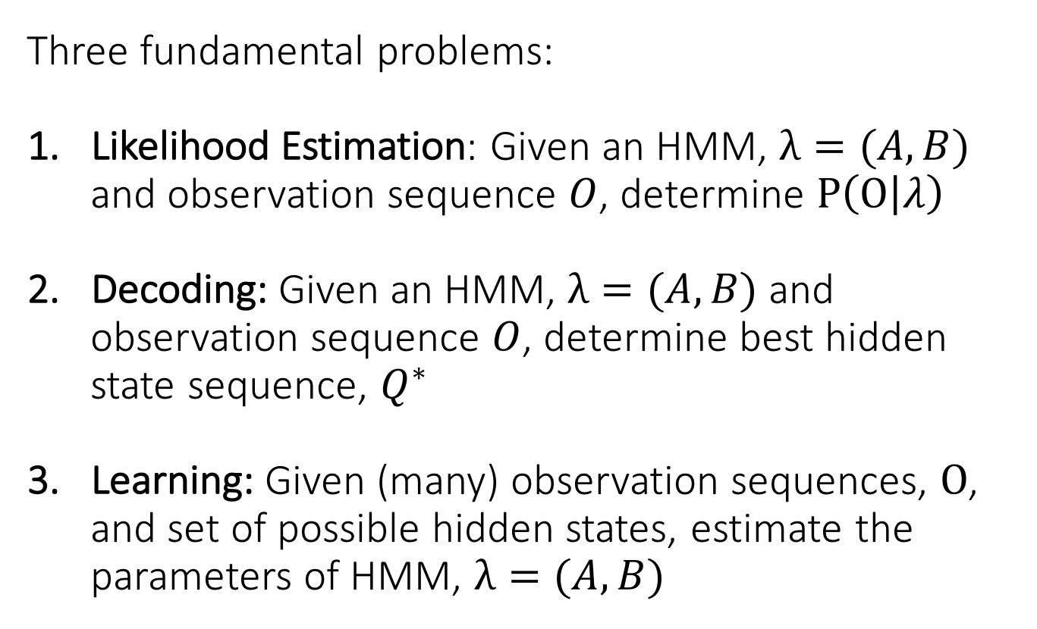
Hidden Markov Models
Three fundamental problems:
Likelihood Estimation: Given an HMM, $λ=(A, B)$ and observation sequence $O$, determine $P\left(O | λ\right)$
Decoding: Given an HMM, $λ=(A, B)$ and observation sequence $O$, determine best hidden state sequence, $Q^{∗}$
Learning: Given (many) observation sequences, $O$, and set of possible hidden states, estimate the parameters of HMM, $λ=(A, B)$

Slide 18
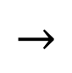



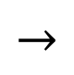
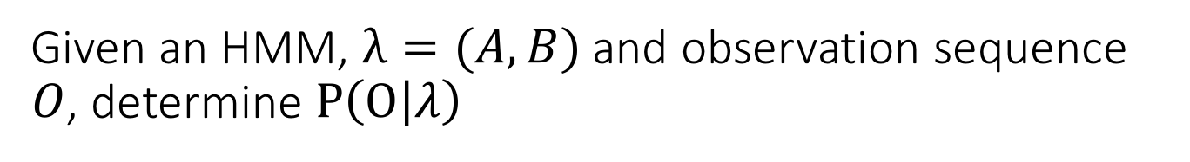
Likelihood Computation
Given an HMM, $λ=(A, B)$ and observation sequence $O$, determine $P\left(O | λ\right)$
Say, O = 3 1 3
For now, let us assume we also know the hidden state sequence, Q = HOT HOT COLD
HOT
$$→$$
HOT
$$→$$
COLD
0.4
$$↓$$
0.1
$$↓$$
0.1
$$↓$$
3
1
3

Slide 19
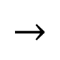



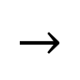
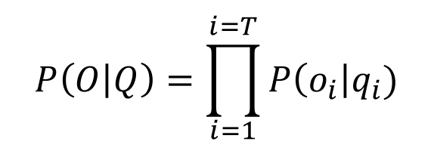
Likelihood Computation
When hidden state sequence, Q is given:
HOT
$$→$$
HOT
$$→$$
COLD
0.4
$$↓$$
0.1
$$↓$$
0.1
$$↓$$
3
1
3
$$P\left(O | Q\right)=\prod_{i=1}^{i=T}{P\left(o_{i}\right|q_{i})}$$
P(3 1 3 | hot hot cold) = P(3 | hot) * P(1 | hot) * P(3 | cold)

Slide 20



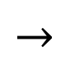


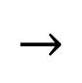
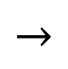



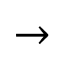
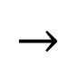

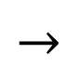



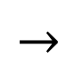
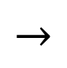
Likelihood Computation
But, Q is not given. Possible options …
HOT
$$→$$
COLD
$$→$$
COLD
HOT
$$→$$
HOT
$$→$$
HOT
$$↓$$
$$↓$$
$$↓$$
$$↓$$
$$↓$$
$$↓$$
3
1
3
3
1
3
COLD
$$→$$
HOT
$$→$$
COLD
HOT
$$→$$
COLD
$$→$$
HOT
$$↓$$
$$↓$$
$$↓$$
$$↓$$
$$↓$$
$$↓$$
3
1
3
3
1
3
How many Q sequences are possible?

Slide 21

Likelihood Computation
But, Q is not given. Possible options …
HOT
$$→$$
COLD
$$→$$
COLD
HOT
$$→$$
HOT
$$→$$
HOT
$$↓$$
$$↓$$
$$↓$$
$$↓$$
$$↓$$
$$↓$$
3
1
3
3
1
3
COLD
$$→$$
HOT
$$→$$
COLD
HOT
$$→$$
COLD
$$→$$
HOT
$$↓$$
$$↓$$
$$↓$$
$$↓$$
$$↓$$
$$↓$$
3
1
3
3
1
3
$$2^{3}=8$$

Slide 22
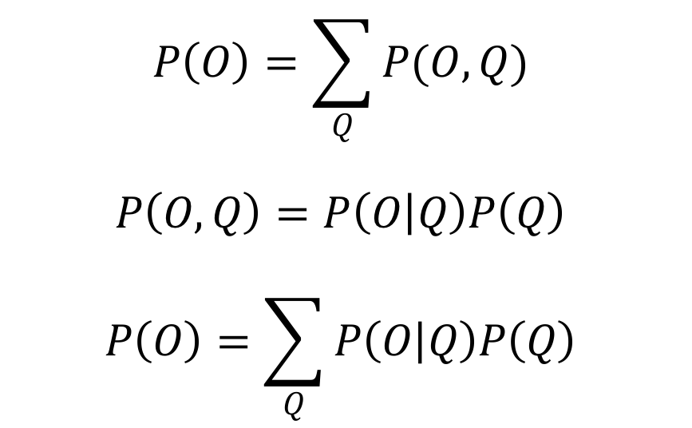
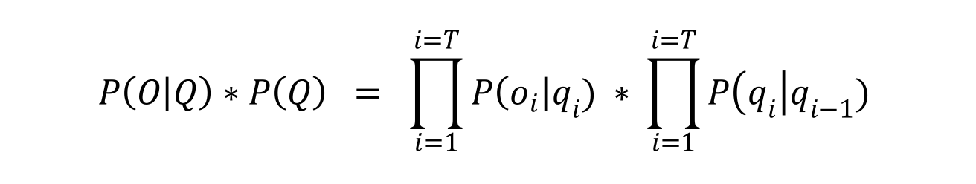
Likelihood Computation
Marginalize over all possible Q
$$P\left(O\right)=\sum_{Q}{P(O, Q)}$$
$$P\left(O, Q\right)=P\left(O | Q\right)P\left(Q\right)$$
$$P\left(O\right)=\sum_{Q}{P\left(O | Q\right)P\left(Q\right)}$$
$$P\left(O | Q\right)∗P\left(Q\right) = \prod_{i=1}^{i=T}{P\left(o_{i}\right|q_{i}) ∗} \prod_{i=1}^{i=T}{P\left(q_{i}\right|q_{i−1})}$$

Slide 23
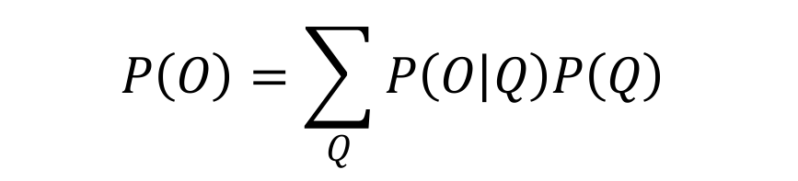
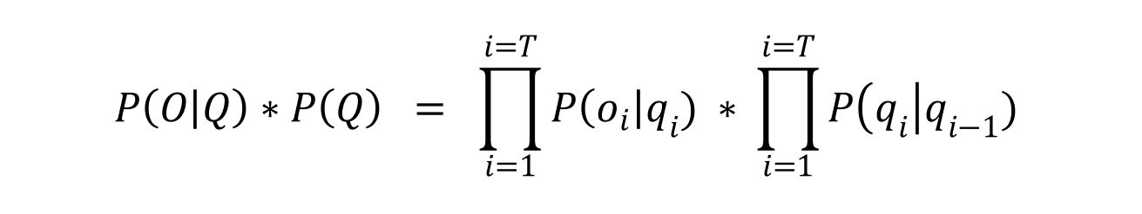
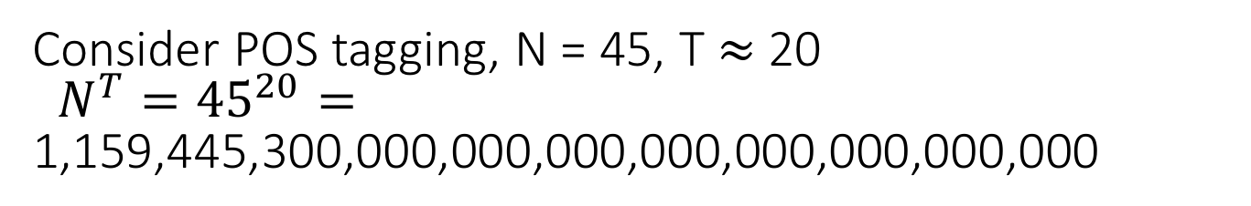
Likelihood Computation
$$P\left(O\right)=\sum_{Q}{P\left(O | Q\right)P\left(Q\right)}$$
Marginalize over all possible Q
$$P\left(O | Q\right)∗P\left(Q\right) = \prod_{i=1}^{i=T}{P\left(o_{i}\right|q_{i}) ∗} \prod_{i=1}^{i=T}{P\left(q_{i}\right|q_{i−1})}$$
Number of possible Qs: $N^{T}$
Consider POS tagging, N = 45, T $≈$ 20
$N^{T}={45}^{20}=\text{1}\text{,}\text{159}\text{,}\text{445}\text{,}\text{3}\text{00,000,0}\text{00}\text{,}\text{000}\text{,}\text{000}\text{,}\text{000}\text{,}\text{000}\text{,}\text{000}\text{,}\text{0}\text{00}$

Slide 24
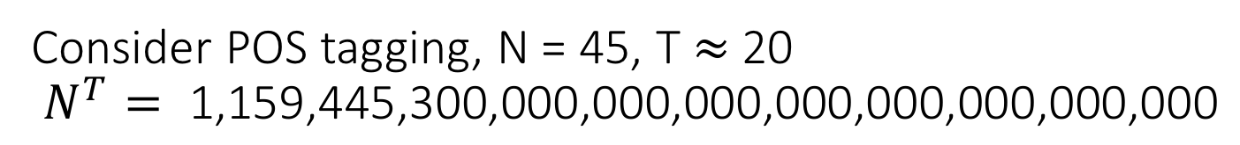
Likelihood Computation
$$P\left(O\right)=\sum_{Q}{P\left(O | Q\right)P\left(Q\right)}$$
Marginalize over all possible Q
$$P\left(O | Q\right)∗P\left(Q\right) = \prod_{i=1}^{i=T}{P\left(o_{i}\right|q_{i}) ∗} \prod_{i=1}^{i=T}{P\left(q_{i}\right|q_{i−1})}$$
Number of possible Qs: $N^{T}$
Consider POS tagging, N = 45, T $≈$ 20
$N^{T}= \text{1}\text{,}\text{159}\text{,}\text{445}\text{,}\text{3}\text{00,000,0}\text{00}\text{,}\text{000}\text{,}\text{000}\text{,}\text{000}\text{,}\text{000}\text{,}\text{000}\text{,}\text{0}\text{00}$
Exponential Running Time: Too expensive!!

Slide 25
Likelihood Computation
$$P\left(O\right)=\sum_{Q}{P\left(O | Q\right)P\left(Q\right)}$$
Marginalize over all possible Q
$$P\left(O | Q\right)∗P\left(Q\right) = \prod_{i=1}^{i=T}{P\left(o_{i}\right|q_{i}) ∗} \prod_{i=1}^{i=T}{P\left(q_{i}\right|q_{i−1})}$$
Number of possible Qs: $N^{T}$
Consider POS tagging, N = 45, T $≈$ 20
$N^{T}= \text{1}\text{,}\text{159}\text{,}\text{445}\text{,}\text{3}\text{00,000,0}\text{00}\text{,}\text{000}\text{,}\text{000}\text{,}\text{000}\text{,}\text{000}\text{,}\text{000}\text{,}\text{0}\text{00}$
Exponential Running Time: Too expensive!!

Slide 26
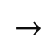


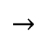
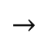


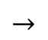
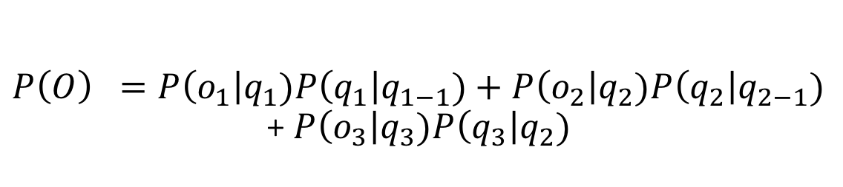
Likelihood Computation: The Forward Algorithm
HOT
$$→$$
COLD
$$→$$
COLD
HOT
$$→$$
COLD
$$→$$
HOT
$$↓$$
$$↓$$
$$↓$$
$$↓$$
$$↓$$
$$↓$$
3
1
3
3
1
3
$P\left(O\right) =P\left(o_{1}\right|q_{1})P\left(q_{1}\right|q_{1−1})+P\left(o_{2}\right|q_{2})P\left(q_{2}\right|q_{2−1})$ + $P\left(o_{3}\right|q_{3})P\left(q_{3}\right|q_{2})$

Slide 27

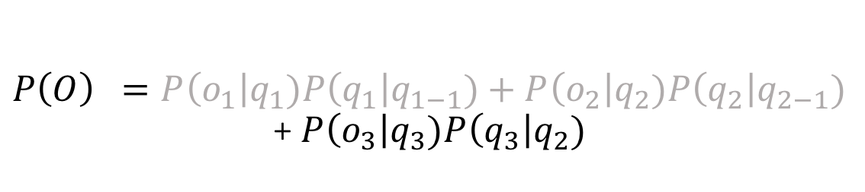
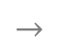


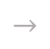
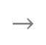


Likelihood Computation: The Forward Algorithm
HOT
$$→$$
COLD
$$→$$
COLD
HOT
$$→$$
COLD
$$→$$
HOT
$$↓$$
$$↓$$
$$↓$$
$$↓$$
$$↓$$
$$↓$$
3
1
3
3
1
3
$P\left(O\right) =P\left(o_{1}\right|q_{1})P\left(q_{1}\right|q_{1−1})+P\left(o_{2}\right|q_{2})P\left(q_{2}\right|q_{2−1})$ + $P\left(o_{3}\right|q_{3})P\left(q_{3}\right|q_{2})$
At t=3, only state at t=2 matters
Let’s try to fold all computations before t=2 into single quantity
Dynamic Programming!!!

Slide 28
Dynamic Programming
Coined by Richard Bellman in 1940s
“My boss, Secretary of Defense, actually had a pathological fear and hatred of the word research”
“Dynamic has a very interesting property as an adjective, and that it's impossible to use the word dynamic in a pejorative sense. Try thinking of some combination that will possibly give it a pejorative meaning. It's impossible!”
Method for solving complex problems by breaking them down into simpler sub-problems and storing their solutions
Technique of storing solutions to sub-problems instead of recomputing them is called ”memoization”

Slide 29
Dynamic Programming
Fibonacci Series
fib(n) = fib(n − 1) + fib(n − 2)
fib(5)
fib(4) + fib(3)
(fib(3) + fib(2)) + (fib(2) + fib(1))
((fib(2) + fib(1)) + (fib(1) + fib(0))) + ((fib(1) + fib(0)) + fib(1))
(((fib(1) + fib(0)) + fib(1)) + (fib(1) + fib(0))) + ((fib(1) + fib(0)) + fib(1))
Instead of calling fib(3) multiple times, we should store it and lookup instead of recomputing

Slide 30
Likelihood Computation: The Forward Algorithm
HOT
$$→$$
COLD
$$→$$
COLD
HOT
$$→$$
COLD
$$→$$
HOT
$$↓$$
$$↓$$
$$↓$$
$$↓$$
$$↓$$
$$↓$$
3
1
3
3
1
3
$P\left(O\right) =P\left(o_{1}\right|q_{1})P\left(q_{1}\right|q_{1−1})+P\left(o_{2}\right|q_{2})P\left(q_{2}\right|q_{2−1})$ + $P\left(o_{3}\right|q_{3})P\left(q_{3}\right|q_{2})$
At t=3, only state at t=2 matters
Let’s try to fold all computations before t=2 into single quantity
Dynamic Programming!!!

Slide 31
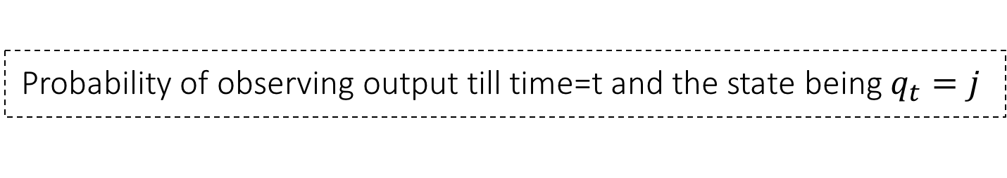


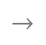
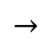
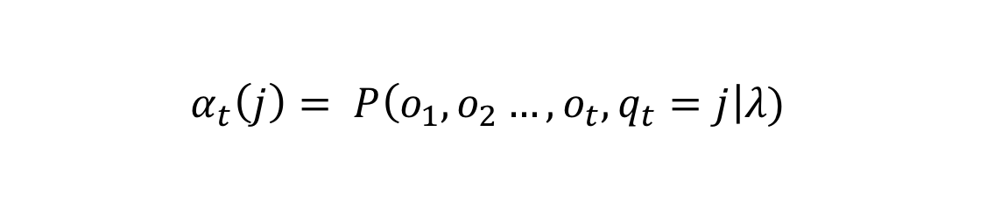


Likelihood Computation: The Forward Algorithm
HOT
$$→$$
COLD
$$→$$
COLD
HOT
$$→$$
COLD
$$→$$
HOT
$$↓$$
$$↓$$
$$↓$$
$$↓$$
$$↓$$
$$↓$$
3
1
3
3
1
3
COLD
$$→$$
COLD
$$→$$
COLD
COLD
$$→$$
COLD
$$→$$
HOT
$$↓$$
$$↓$$
$$↓$$
$$↓$$
$$↓$$
$$↓$$
3
1
3
3
1
3
Probability of observing output till t=2 and the state being $q_{2}=COLD$
$$P\left(o_{1}, o_{2}, q_{2}=COLD\right|λ)=α_{2}\left(COLD\right)$$
Probability of observing output till time=t and the state being $q_{t}=j$
$$α_{t}\left(j\right)= P\left(o_{1}, o_{2}…, o_{t}, q_{t}=j\right|λ)$$

Slide 32








Likelihood Computation: The Forward Algorithm
Probability of observing output till t and the state being $q_{2}=j$
$$α_{t}\left(j\right)= P\left(o_{1}, o_{2}…, o_{t}, q_{t}=j\right|λ)$$
Using independence assumption of our model (and recursion):
Sum over all possible values $q_{t}$
P(A,B) = P(A|B)P(B)
$$α_{t+1}\left(i\right)=\sum_{j=1}^{N}{α_{t}\left(j\right)∗a_{ji}∗b_{i}(o_{t+1})}$$
$$P\left(o_{t+1}\right|q_{t+1}=i)$$
$$P\left(o_{1}, o_{2}…, o_{t},o_{t+1}, q_{t+1}=i\right|λ)$$
$$P\left(q_{t+1}=i\right|q_{t}=j)$$
$$P\left(o_{1}, o_{2}…, o_{t}, q_{t}=j\right|λ)$$

Slide 33




Likelihood Computation: The Forward Algorithm
$$α_{t}\left(i\right)=\sum_{j=1}^{N}{α_{t−1}\left(j\right)∗a_{ji}∗b_{i}(o_{t})}$$
$$α_{t}\left(i\right)= P\left(o_{1}, o_{2}…, o_{t}, q_{t}=i\right|λ)$$
$$P\left(o_{1}, o_{2}…, o_{T}\right|λ) =\sum_{i=1}^{N}{P\left(o_{1}, o_{2}…, o_{T}, q_{T}=i\right|λ){∗a}_{iF} }$$
$$P\left(O\right)= P\left(o_{1}, o_{2}…, o_{T}\right|λ) =\sum_{i=1}^{N}{α_{T}\left(i\right){∗a}_{iF} }$$

Slide 34




Likelihood Computation: The Forward Algorithm
Recap, to compute P(O):
$$α_{t}\left(i\right)= P\left(o_{1}, o_{2}…, o_{t}, q_{t}=i\right|λ)$$
Initialization:
$$α_{1}\left(i\right)=a_{0i}b_{i}\left(o_{1}\right) 1≤i≤N$$
$$α_{t}\left(i\right)=\sum_{j=1}^{N}{α_{t−1}\left(j\right)∗a_{ji}∗b_{i}(o_{t})}$$
Recursion:
$$P\left(O\right)= P\left(o_{1}, o_{2}…, o_{T}\right|λ) =\sum_{i=1}^{N}{α_{T}\left(i\right){∗a}_{iF} }$$
Termination:

Slide 35

Decoding – Viterbi Algorithm
Given an HMM, $λ=(A, B)$ and observation sequence $O$, determine best hidden state sequence, $Q^{∗}$
Let us learn about HMMs
VB PRP VB IN NNP
p=0.45
IN VB VB NN DT
p=0.03
…
PRP . NN IN WP
p=0.00006

Slide 36




Decoding – Viterbi Algorithm
Given an HMM, $λ=(A, B)$ and observation sequence $O$, determine best hidden state sequence, $Q^{∗}$
$$Q^{∗}=\underset{Q}{argmax}{P(Q|O)}$$
$$Q^{∗}=\underset{Q}{argmax}{\frac{P\left(O | Q\right)P(Q)}{P(O)}}$$
$$\frac{P\left(O | Q\right)P(Q)}{P(O)}=P\left(O | Q\right)P(Q)$$
$$Q^{∗}=\underset{Q}{argmax}{P\left(O | Q\right)P(Q) }$$

Slide 37



Decoding – Viterbi Algorithm
$$Q^{∗}=\underset{Q}{argmax}{P\left(O | Q\right)P(Q) }$$
Number of possible Qs: $N^{T}$
Remember,
$$P\left(O\right)=\sum_{Q}{P\left(O | Q\right)P\left(Q\right)}$$
We know how to compute this sum efficiently!
Can we use the same intuition to compute the argmax efficiently?

Slide 38



Decoding – Viterbi Algorithm
Let us first try to find the max instead of the argmax
$$P^{∗}=\max_{Q} P\left(Q | O\right)=\max_{Q} \frac{P(O,Q)}{P(O)}=\max_{Q} P(O,Q){ }$$
(Not exactly) Probability of the best hidden sequence up till time = t, ending in $q_{t}=j$
$$v_{t}(j)=\max_{q_{1},…,q_{t−1}}{P(q_{1},…,q_{t−1},o_{1},o_{2},…,o_{t}, q_{t}=j|λ) }$$

Slide 39



Decoding – Viterbi Algorithm
Probability of the best hidden sequence up till time = t, ending in $q_{t}=j$
$$v_{t}(j)=\max_{q_{1},…,q_{t−1}}{P(q_{1},…,q_{t−1},o_{1},o_{2},…,o_{t}, q_{t}=j|λ) }$$
Use independence assumption to recurse:
Max over transitions from all possible $q_{t}$
$$v_{t+1}(i)=\max_{j=1,…,N }{v_{t}\left(j\right)∗a_{ji}∗b_{i}(o_{t+1}) }$$
$$P\left(o_{t+1}\right|q_{t+1}=i)$$
$$P\left(o_{1}, o_{2}…, o_{t},o_{t+1}, q_{t+1}=i\right|λ)$$
$$P\left(q_{t+1}=i\right|q_{t}=j)$$
$$P(q_{1},…,q_{t−1},o_{1},o_{2},…,o_{t}, q_{t}=j|λ)$$

Slide 40



Decoding – Viterbi Algorithm
$$v_{T}(j)=\max_{q_{1},…,q_{T−1}}{P(q_{1},…,q_{T−1},o_{1},o_{2},…,o_{T}, q_{T}=j|λ) }$$
$${P^{∗}=\max_{j=1,…,N} v}_{T}(j)$$
To find $Q^{∗}$, add back-pointers
$$v_{t+1}(i)=\max_{j=1,…,N }{v_{t}\left(j\right)∗a_{ji}∗b_{i}(o_{t+1}) }$$
$${bt}_{t+1}(i)=\underset{j=1,…,N }{argmax}{v_{t}\left(j\right)∗a_{ji}∗b_{i}(o_{t+1}) }$$
If ending the sequence at $q_{t+1}\left(i\right)$, what is the best $q_{t}$

Slide 41








Decoding – Viterbi Algorithm
$$v_{2}\left(A\right)$$
$$v_{1}\left(A\right)∗a_{AA}∗b_{A}(o_{2})$$
$$v_{1}(A)$$
$$v_{1}\left(B\right)∗a_{BA}∗b_{A}(o_{2})$$
$${bt}_{2}\left(A\right)$$
$$v_{1}(B)$$
$$v_{1}\left(C\right)∗a_{CA}∗b_{A}(o_{2})$$
$$v_{1}(C)$$

Slide 42

Decoding – Viterbi Algorithm
$$v_{2}\left(A\right)$$
$$v_{1}(A)$$
$$v_{2}\left(B\right)$$
$$v_{1}(B)$$
$$v_{1}(C)$$

Slide 43

Decoding – Viterbi Algorithm
$$v_{2}\left(A\right)$$
$$v_{1}(A)$$
$$v_{2}\left(B\right)$$
$$v_{1}(B)$$
$$v_{2}\left(C\right)$$
$$v_{1}(C)$$

Slide 44




Decoding – Viterbi Algorithm
$$v_{2}\left(A\right)$$
$$v_{3}\left(A\right)$$
$$v_{1}(A)$$
$$v_{2}\left(B\right)$$
$$v_{3}\left(B\right)$$
$$v_{1}(B)$$
$$v_{2}\left(C\right)$$
$$v_{3}\left(C\right)$$
$$v_{1}(C)$$
$${q_{T=3}^{∗}=\underset{j=1,…,N}{argmax} v}_{T=3}\left(j\right)=C$$

Slide 45
Decoding – Viterbi Algorithm
$$v_{2}\left(A\right)$$
$$v_{3}\left(A\right)$$
$$v_{1}(A)$$
$$v_{2}\left(B\right)$$
$$v_{3}\left(B\right)$$
$$v_{1}(B)$$
$$v_{2}\left(C\right)$$
$$v_{3}\left(C\right)$$
$$v_{1}(C)$$
$${q_{T=3}^{∗}=\underset{j=1,…,N}{argmax} v}_{T=3}\left(j\right)=C$$

Slide 46


Decoding – Viterbi Algorithm
$$v_{2}\left(A\right)$$
$$v_{3}\left(A\right)$$
$$v_{1}(A)$$
$$v_{2}\left(B\right)$$
$$v_{3}\left(B\right)$$
$$v_{1}(B)$$
$$v_{2}\left(C\right)$$
$$v_{3}\left(C\right)$$
$$v_{1}(C)$$
$${q_{T=3}^{∗}=\underset{j=1,…,N}{argmax} v}_{T=3}(j)=C$$
$$Q^{∗}=B A C$$

Slide 47


Learning an HMM
Given (many) observation sequences, $\{O_{i}\}$and the set of possible hidden states, estimate the parameters of HMM, $λ=(A, B)$
$$A={[a}_{ij}]=P\left(q_{t}=j | q_{t−1}=i\right)$$
$$B=[b_{j}(o_{t})]=P\left(o_{t} | q_{t}=j\right)$$

Slide 48

Learning an HMM
So just by looking at sentences, can we learn a POS tagging model?
$$A={[a}_{ij}]=P\left(q_{t}=j | q_{t−1}=i\right)$$
$$B=[b_{j}(o_{t})]=P\left(o_{t} | q_{t}=j\right)$$

Slide 49
Learning an HMM
Turns out, we can!
This is an example of unsupervised learning.

Slide 50



Learning an HMM
Let’s consider a simpler case, where we are given $\{O_{i}, Q_{i}\}$ sequence pairs
Similar, to a language model, counting should’ve worked!
$$a_{ij}= \frac{C(i→j)}{\sum_{q∈Q}{C(i→q)}}$$
$$b_{j}(o)= \frac{C(j→o)}{\sum_{o^{′}∈Vocab(o^{′})}{C(j→o^{′})}}$$

Slide 51



Learning an HMM
But, we only have unlabeled sequences, $\{O_{i}\}$.
Why do we even expect to learn (A,B)?
Consider, multiple pairs of (A,B) = $\{\left(A_{1}, B_{1}\right),\left(A_{2}, B_{2}\right),\left(A_{3}, B_{3}\right), …, \left(A_{N}, B_{N}\right)\}$
For each $\left(A_{x}, B_{x}\right)$, we can compute
$$Likelihood_{x}= \prod_{i}{P(O_{i}|\left(A_{x}, B_{x}\right))}$$
Choose best $\left(A_{x}, B_{x}\right)$

Slide 52
Learning an HMM
Infinite number of possibilities for $(A,B)$
Can we do something smarter?
Expectation – Maximization is an algorithm to find parameters of a statistical model containing hidden variables

Slide 53

Learning an HMM
EM is an iterative algorithm. Let’s draw a sketch of the algorithm:
Start with some estimate of parameters, $\left(A,B\right)$
Compute an expectation of the likelihood of the observed data using current parameter estimates
Update parameters $\left(A,B\right)$ so as to maximize the expectation computed in Step 2
Repeat 2. & 3. until some stopping criterion

Slide 54

Learning an HMM
EM is an iterative algorithm. Let’s draw a sketch of the algorithm:
Start with some estimate of parameters, $\left(A,B\right)$
Compute an expectation of the likelihood of the observed data using current parameter estimates
Update parameters $\left(A,B\right)$ so as to maximize the expectation computed in Step 2
Repeat 2. & 3. until some stopping criterion
Optimum $(A,B)$ are found!

Slide 55
What we learned..
Hidden Markov Models allow us to model sequences with hidden latent variables
Likelihood: Given a observation sequence, computing its likelihood
Decoding: Given an observation sequence, decoding the best hidden sequence of labels
Learning: Using unlabeled sequence examples, learning the parameters of a HMM.

